Slide 1


Helena Mbeua Pedro
2022/02/06

Slide 2

Outline
Executive Summary
Introduction
Methodology
Results
Conclusion
Appendix

Slide 3
Executive Summary
This project is based on the analyzes of SpaceX data, with a strong predictive value of machine learning model that has a 88.7% of accuracy rate. The methodology used implied
Data collection: to predict if the Falcon 9 first stage will land successfully, if so, also determine the cost of a launch.
Data wrangling: to perform some EDA to find some patterns in the data and determine what would be the label for training supervised models.
Exploratory data analysis (EDA) using visualization and SQL: to determine if the first stage will land, in order to determine the cost of a launch.
Interactive visual analytics using Folium and Plotly Dash: to perform more interactive visualization tools
Predictive analysis using classification models

Slide 4
Executive Summary
The results obtained demonstrated that:
Launch sites are in close proximity to coastline so they can fly over the ocean during launch, for at least two safety reasons-- (1) crew has option to abort launch and attempt water landing (2) minimize people and property at risk from falling debris.
Launch sites are in close proximity to highways, which allows for easily transport required people and property.
Launch sites are in close proximity to railways, which allows transport for heavy cargo.
Launch sites are in close proximity to equator to minimize fuel consumption by using Earth's ~ 30km/sec eastward spin to help spaceships get into orbit.
Launch sites are not in close proximity to cities, which minimizes danger to population dense areas.
After comparing accuracy of all methods used in the predictive analysis , it was conclused that, they all preformed practically the same, except for tree which fit train data slightly better but test data worse.

Slide 5
Introduction
SpaceX is the only private company ever to return a spacecraft from low-earth orbit, which it first accomplished in December 2010.
SpaceX advertises Falcon 9 rocket launches on its website with a cost of 62 million dollars whereas other providers cost upward of 165 million dollars each, much of the savings is because Space X can reuse the first stage.
Therefore determine if the first stage will land, allows us to determine the cost of a launch. This information can be used if an alternate company wants to bid against SpaceX for a rocket launch.
Problems to find answers:
Determine if the first stage will land
Determine the cost of a launch

Slide 6

Section 1

Slide 7
Methodology
Executive Summary
Data collection methodology:
Data was collected using the Webscraping and SpaceX Rest API
Perform data wrangling
Data was processed by applying one-hot encoding to categorical features
Perform exploratory data analysis (EDA) using visualization and SQL
Perform interactive visual analytics using Folium and Plotly Dash
Perform predictive analysis using classification models
Decision trees, Logistic Regression, SVM and KNN

Slide 8
Data Collection
The data was collected from SpaceX API, then it was returned in .JSON and finally saved into CSV format.
In the process, it was cleaned and the missing values was treated. It was used the get request to collect the data. Than, using BeautfulSoup, it was performed the web scraping for Falcon 9 launches from Wikipedia

Slide 9
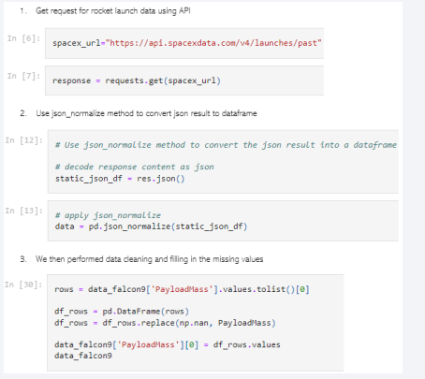
Data Collection – SpaceX API
Data collection with SpaceX REST calls:
Get request
Rest API
Data cleaning and filling perform
GitHub URL of the completed SpaceX API calls notebook: https://github.com/HellemWanilda/Applied-Data-Science-

Slide 10
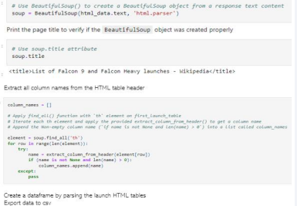
Data Collection - Scraping
Web scraping process: Used BeautfulSoup to webscrap Falcon 9 launch
web scraping notebook:
https://github.com/HellemWanilda/Applied-Data-Science-

Slide 11
Data Wrangling
About the Data Wrangling Process, it was:
Done the Exploratory data analysis (0 or 1 as a dummy variables where 1 indicates the successful and 0 indicates the unsuccessful),
Determined the training labels, calculated the number of launches at each site, the number and occurrence of each orbits
Created a landing outcome label from outcome column. Finally, it was exported the results to csv.
Check the following link to see the completed data wrangling notebooks:
https://eu-gb.dataplatform.cloud.ibm.com/analytics/notebooks/v2/36a8aeca-aeb1-4918-9dc0-0d7e129ce38d/view?access_token=a441d0551d6f137c1b6a22ed56b63cfd32a6594b746a6193f98e64d1dac3e0cc

Slide 12
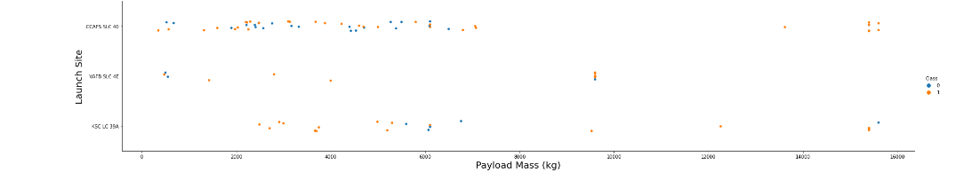
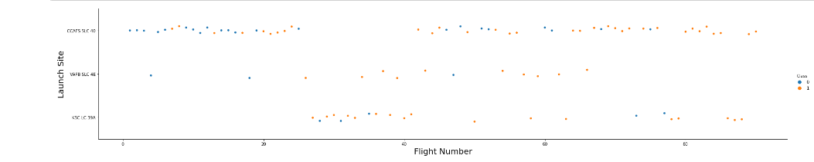
https://github.com/HellemWanilda/Applied-Data-Science-
EDA with Data Visualization
Here it can be seen the relationship between payload Vs. Launch Site and Launch site vs Flight number. Please check the link for explanations

Slide 13
EDA with SQL
SQL queries performed:
It was loaded the SpaceX dataset into a PostgreSQL database without leaving the Jupyter notebook.
• It was applied EDA with SQL to get insight from the data, evaluating the relationship between launch site, launch date, payload, booster type and mission outcome
It was wrote queries to find out for instance: the names of unique launch sites in the space mission; total payload mass carried by boosters launched by NASA (CRS); average payload mass carried by booster version F9 v1.1; total number of successful and failure mission outcomes and the failed landing outcomes in drone ship, their booster version and launch site names.
https://github.com/HellemWanilda/Applied-Data-Science-

Slide 14
Build an Interactive Map with Folium
It was marked all launch sites, and added map objects such as markers, circles, lines to mark the success or failure of launches for each site on the folium map.
It was assigned the feature launch outcomes (failure or success) to class 0 and 1.i.e., 0 for failure, and 1 for success.
It was used the color-labeled marker clusters, to identifie which launch sites have relatively high success rate.
It was calculated the distances between a launch site to its proximities.
Finally it was provided answers to the following questions like:
Are launch sites near railways, highways and coastlines
Do launch sites keep certain distance away from cities
https://github.com/HellemWanilda/Applied-Data-Science-

Slide 15
Build a Dashboard with Plotly Dash
It was built an interactive dashboard with Plotly dash
It was plotted pie charts showing the total launches (successful and unsuccessful launches) by a certain sites •
Also, it was plotted scatter graph showing the relationship with Outcome and Payload Mass (Kg) for the different booster version. A scatterplot maps recovery outcome vs. payload mass
https://github.com/HellemWanilda/Applied-Data-Science-

Slide 16
Predictive Analysis (Classification)
For predictive analysis, the important libraries used was numpy and pandas
The machine learning models that was built to predict the best successful launches are:
Logistic Regression
K-Nearest Neighbor (KNN)
Decision Trees
Support Vector Machine (SVM
Each of these methods splits the data into testing and training sets, it was used accuracy as the metric for the model, and also, it was improved the model using feature engineering and algorithm tuning.
https://github.com/HellemWanilda/Applied-Data-Science-

Slide 17
Results
Exploratory data analysis results
Interactive analytics demo in screenshots
Predictive analysis results

Slide 18

Section 2

Slide 19
Flight Number vs. Launch Site
Show a scatter plot of Flight Number vs. Launch Site
From the plot above it can be conclused that:
CCAFS SLC 40 it is the most common launch site
The larger the flight amount at a launch site, the greater the success rate at a launch site
launches have a 66.6% of success rate

Slide 20
Payload vs. Launch Site
Show a scatter plot of Payload vs. Launch Site
VAFB-SLC does not launch any heavy payloads
The higher success rate was for the rockes
The greater the payload mass was for a launch site CCAFS SLC 40

Slide 21
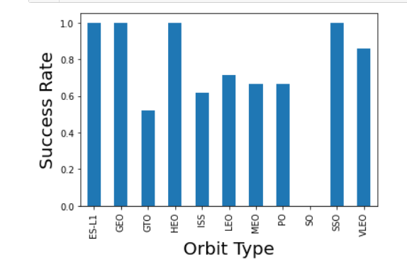
Success Rate vs. Orbit Type
Show a bar chart for the success rate of each orbit type
GEO, HEO, SSO, VLEO and ES-L1 had the most success rate by mean

Slide 22
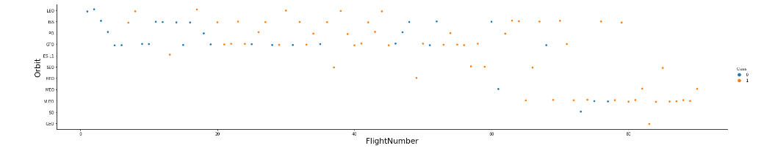
Flight Number vs. Orbit Type
Show a scatter point of Flight number vs. Orbit type
From the plot bellow, it can be seen that, LEO orbit success apparently it is correlated to the number of flights and there is no relationship for GTO orbit

Slide 23
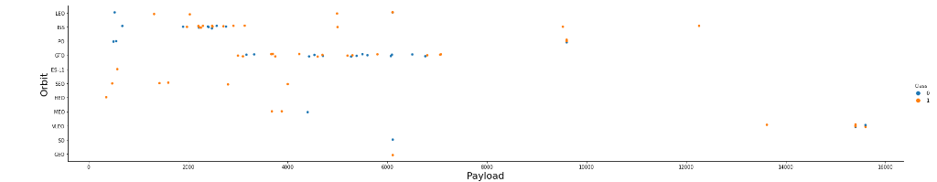
Payload vs. Orbit Type
There is successfully heavy payloads for the Polar, LEO and ISS

Slide 24
Launch Success Yearly Trend
Please follow the link below to see the line chart of yearly average success rate
https://github.com/HellemWanilda/Applied-Data-Science-
From the line chart, it can be seen that there is a significant improvement since 2014 and it was increasing until 2020

Slide 25
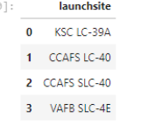
All Launch Site Names
Launch site names:
It was use the DISTINCT key word

Slide 26
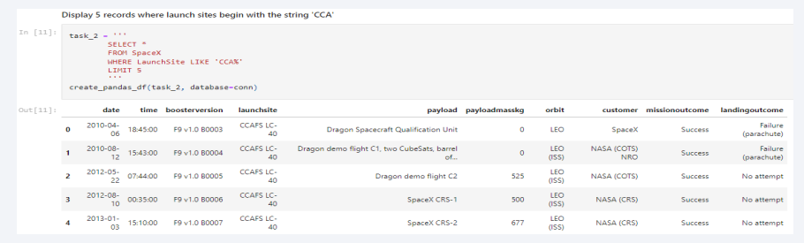
Launch Site Names Begin with 'CCA'
The query above shows the result of 5 records where launch sites begin with `CCA`

Slide 27
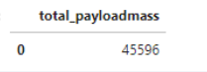
Total Payload Mass
Calculus of the total payload carried by boosters from NASA:

Slide 28
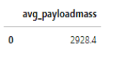
Average Payload Mass by F9 v1.1
It was calculated the average payload mass carried by booster version F9 v1.1

Slide 29
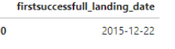
First Successful Ground Landing Date
Above it can be seen the dates of the first successful landing outcome on ground pad

Slide 30
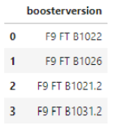
Successful Drone Ship Landing with Payload between 4000 and 6000
List of the names of boosters which have successfully landed on drone ship and had payload mass greater than 4000 but less than 6000

Slide 31
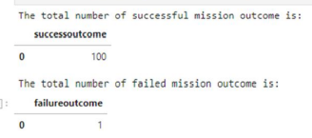
Total Number of Successful and Failure Mission Outcomes
Total number of successful and failure mission outcomes:

Slide 32
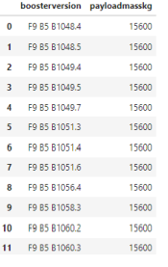
Boosters Carried Maximum Payload
List of the names of the booster which the maximum payload mass carried:

Slide 33
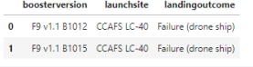
2015 Launch Records
Below are the landing outcomes in drone ship, their booster versions and launch site names for in year 2015

Slide 34
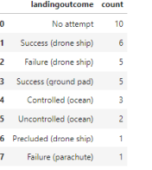
Rank Landing Outcomes Between 2010-06-04 and 2017-03-20
Count of landing outcomes between the date 2010-06-04 and 2017-03-20, in descending order

Slide 35

Section 3

Slide 36
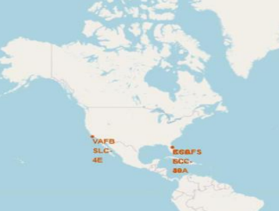
Map with folium
Launch sites are in close proximity to coastline so they can fly over the ocean during launch, for at least two safety reasons-- (1) crew has option to abort launch and attempt water landing (2) minimize people and property at risk from falling debris.
Launch sites are in close proximity to highways, which allows for easily transport required people and property.
Launch sites are in close proximity to railways, which allows transport for heavy cargo.
Launch sites are in close proximity to equator to minimize fuel consumption by using Earth's ~ 30km/sec eastward spin to help spaceships get into orbit.
Launch sites are not in close proximity to cities, which minimizes danger to population dense areas.
After comparing accuracy of all methods used in the predictive analysis , it was conclused that, they all preformed practically the same, except for tree which fit train data slightly better but test data worse.

Slide 37
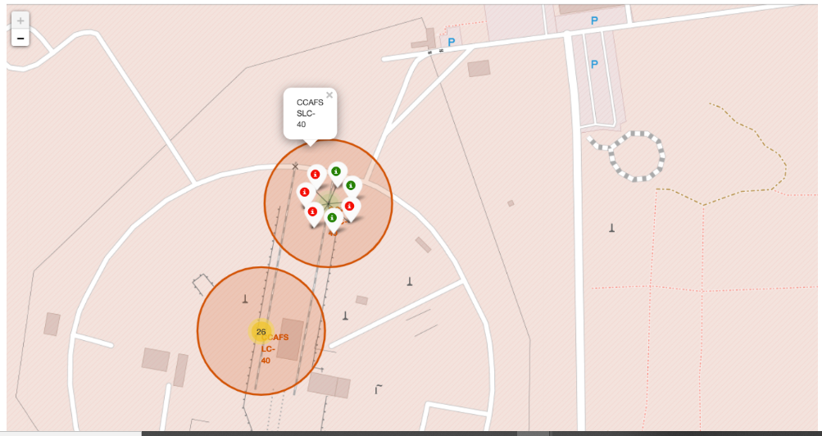
Interactive Folium Map - Screenshot 2
Results of launches with green and red markes showing the successful and failure respectively

Slide 38
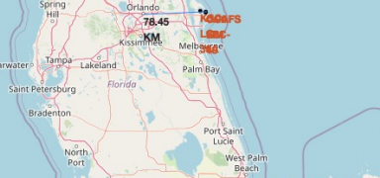
Interactive Folium Map - Screenshot 3
Larger population distance image

Slide 39

Section 4

Slide 40
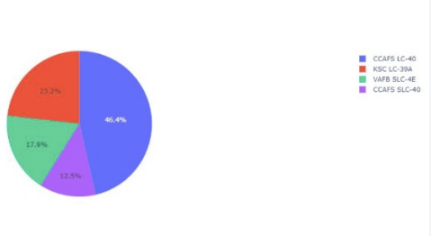
Dashboard with Plotly dash
CCAFS SLC-40 had the least success percentage and CCAFSA LC-40 had the most

Slide 41
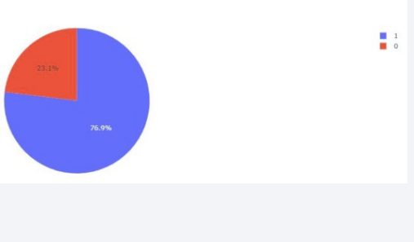
Dashboard with Plotly dash
KSC LC39A had the most and the best sucess

Slide 42
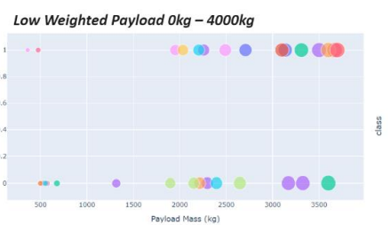
Dashboard with Plotly dash

Slide 43

Section 5

Slide 44
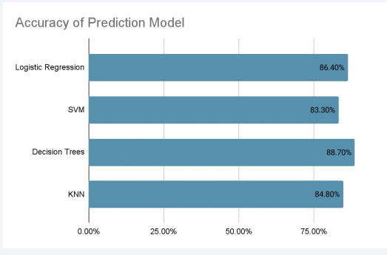
Classification Accuracy
Decision Tree is the model that has the highest classification 88.70% accuracy

Slide 45
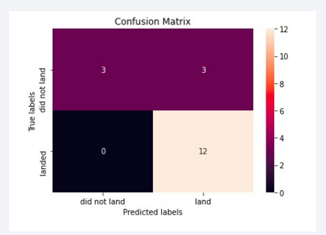
Confusion Matrix
This is a decision tree matrix ha shows the different classes that the classifier can be distinguish
The problem is the unsuccessful landing marked as successful by the classifier because of the false positive problem
It means that it does incorrect assume 3 landing that is not accurate

Slide 46
Conclusions
the first successful landing outcome on ground pad was in 2015/12/22
The larger the flight amount at a launch site, the greater the success rate at a launch site
Payloads between 2,000 -4,000kg are most successfu
Decision Tree is the model that has the highest classification 88.70% accuracy
KSC LC39A had the most and the best success lunches of any site

Slide 47


